Slide 1
MA3077 (DLI) Operational Research Lecture 17 – The exponential distribution
Dr Marco Fasondini

Slide 2
Recapitulation and lecture outline
Summary: so far, we have learnt about the rudiments of queueing theory and Little’s formulae.
In this lecture: The exponential distribution (following closely Ch. 17.4 of the book by Hillier and Lieberman).

Slide 3
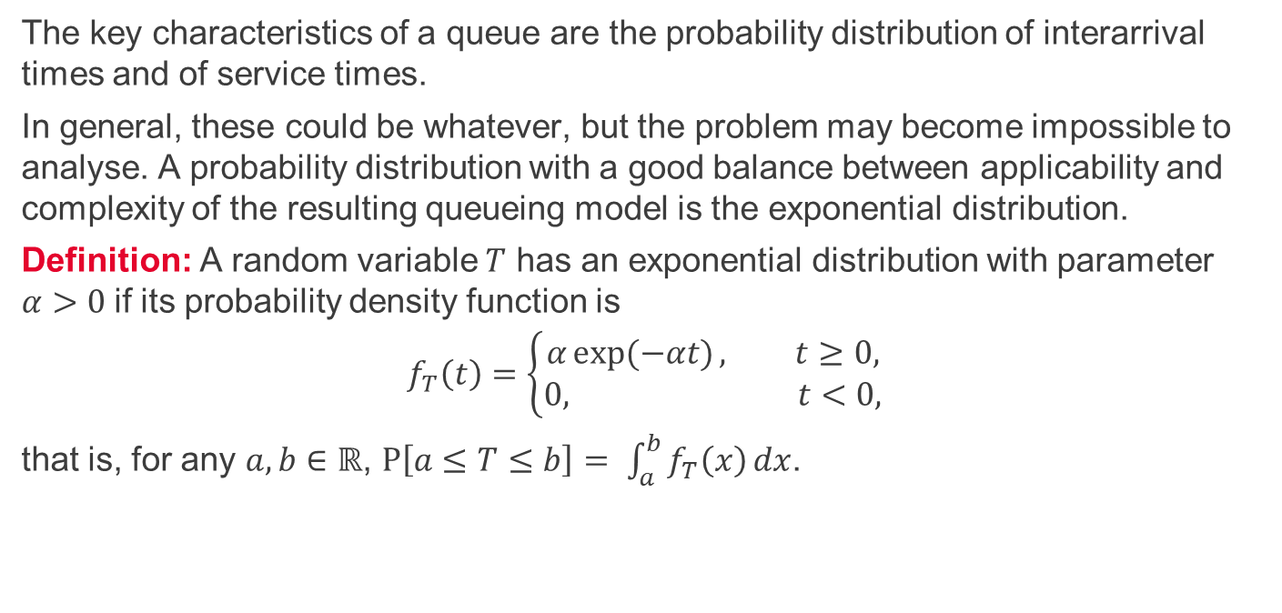
The exponential distribution
The key characteristics of a queue are the probability distribution of interarrival times and of service times.
In general, these could be whatever, but the problem may become impossible to analyse. A probability distribution with a good balance between applicability and complexity of the resulting queueing model is the exponential distribution.
Definition: A random variable $T$ has an exponential distribution with parameter $α>0$if its probability density function is
$$f_{T}\left(t\right)=\left\{\begin{aligned}α\exp{(−αt)}, t≥0, \\ &0, t<0,\end{aligned}\right.$$
that is, for any $a,b∈ℝ$, $P\left[a≤T≤b\right]= \int_{a}^{b}{f_{T}\left(x\right)}dx$.

Slide 4
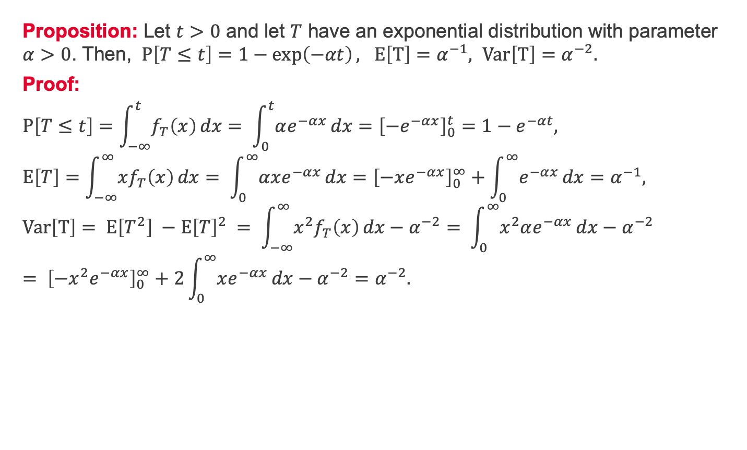
The exponential distribution – property 0
Proposition: Let $t>0$ and let $T$ have an exponential distribution with parameter $α>0$. Then, $P\left[T≤t\right]=1−\exp\left(−αt\right), E\left[T\right]=α^{−1}, Var\left[T\right]=α^{−2}.$
Proof:
$$P\left[T≤t\right]=\int_{−∞}^{t}{f_{T}\left(x\right)}dx= \int_{0}^{t}{αe^{−αx}}dx={\left[−e^{−αx}\right]}_{0}^{t}=1−e^{−αt}, \\ E\left[T\right]=\int_{−∞}^{∞}{xf_{T}\left(x\right)}dx= \int_{0}^{∞}{αxe^{−αx}}dx={\left[−xe^{−αx}\right]}_{0}^{∞}+\int_{0}^{∞}{e^{−αx}}dx=α^{−1}, \\ Var\left[T\right]= E\left[T^{2}\right] −E{\left[T\right]}^{2} = \int_{−∞}^{∞}{x^{2}f_{T}\left(x\right)}dx−α^{−2}= \int_{0}^{∞}{x^{2}αe^{−αx}}dx−α^{−2}= {\left[−x^{2}e^{−αx}\right]}_{0}^{∞}+2\int_{0}^{∞}{xe^{−αx}}dx−α^{−2}=α^{−2}.$$

Slide 5
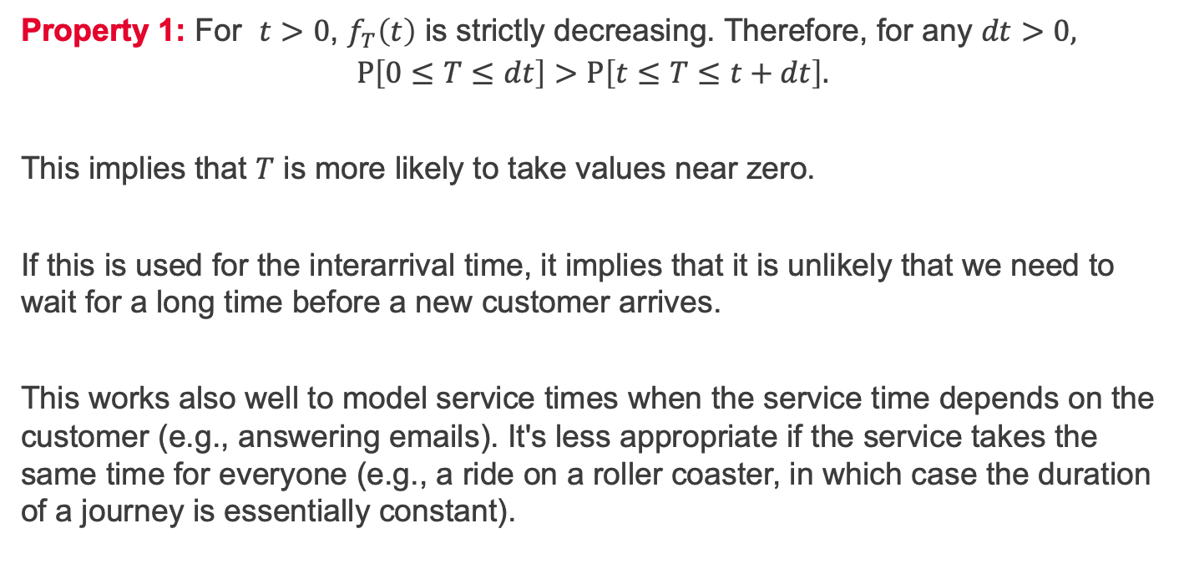
The exponential distribution – property 1
Property 1: For $t>0$, $f_{T}\left(t\right)$ is strictly decreasing. Therefore, for any $dt>0,$
$$P\left[0≤T≤dt\right]>P\left[t≤T≤t+dt\right].$$
This implies that $T$ is more likely to take values near zero.
If this is used for the interarrival time, it implies that it is unlikely that we need to wait for a long time before a new customer arrives.
This works also well to model service times when the service time depends on the customer (e.g., answering emails). It's less appropriate if the service takes the same time for everyone (e.g., a ride on a roller coaster, in which case the duration of a journey is essentially constant).

Slide 6
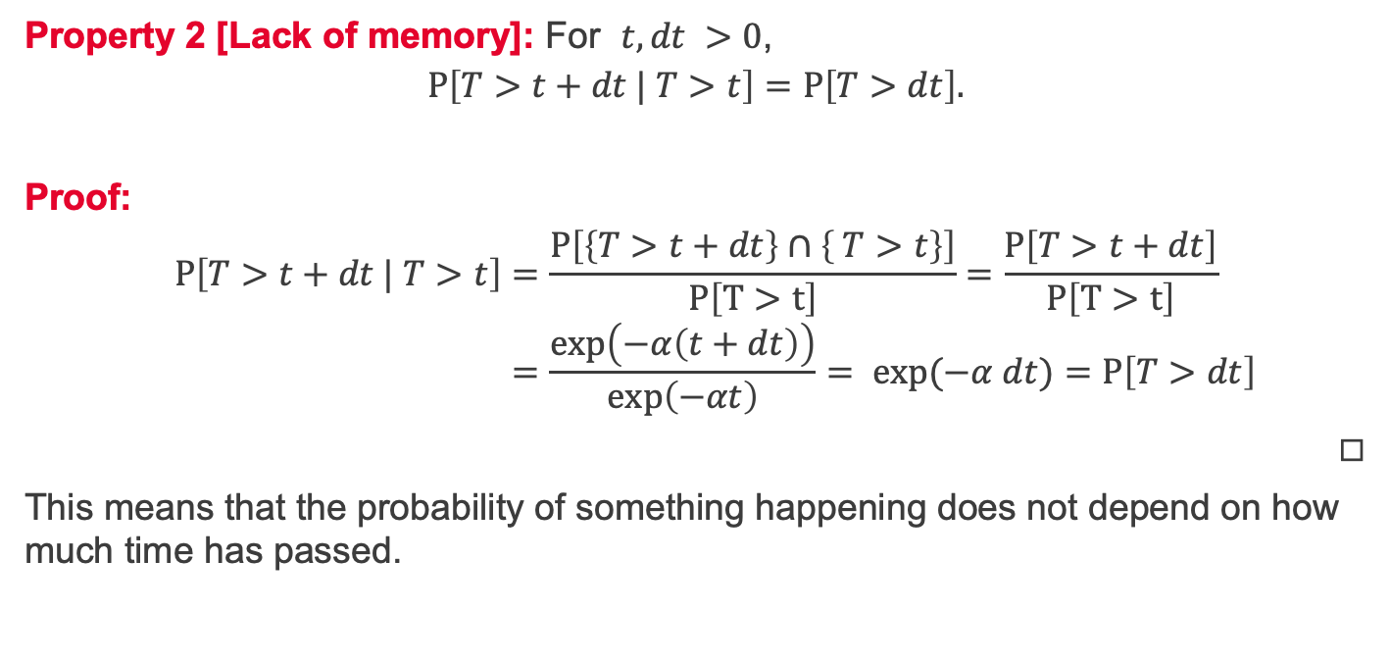
The exponential distribution – property 2
Property 2 [Lack of memory]: For $t,dt >0$,
$$P\left[T>t+dt | T>t\right]=P\left[T>dt\right].$$
Proof:
$$P\left[T>t+dt | T>t\right]=\frac{P\left[\left\{T>t+dt\right\}∩\left\{ T>t\right\}\right]}{P\left[T>t\right]}=\frac{P\left[T>t+dt\right]}{P\left[T>t\right]} \\ =\frac{\exp\left(−α\left(t+dt\right)\right)}{\exp\left(−αt\right)}= exp{(−α dt)}=P\left[T>dt\right]$$
◻︎
This means that the probability of something happening does not depend on how much time has passed.

Slide 7
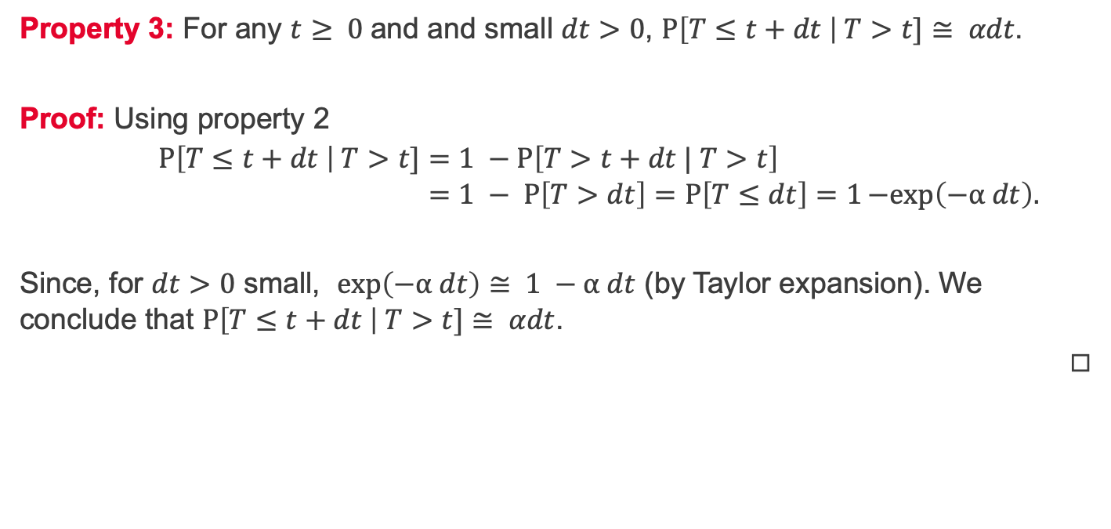
The exponential distribution – property 3
Property 3: For any $t≥ 0$and and small $dt>0$, $P\left[T≤t+dt \right| T>t]≅ αdt$.
Proof: Using property 2
$$P\left[T≤t+dt \right| T>t]=1 −P\left[T>t+dt | T>t\right] \\ =1 − P\left[T>dt\right]=P\left[T≤dt\right]=1−exp\left(−α dt\right).−\exp\left(−αdt\right).$$
Since, for $dt>0$ small, $\exp\left(−α dt\right)≅ 1 −α dt$ (by Taylor expansion). We conclude that $P\left[T≤t+dt \right| T>t]≅ αdt$.
◻︎

Slide 8
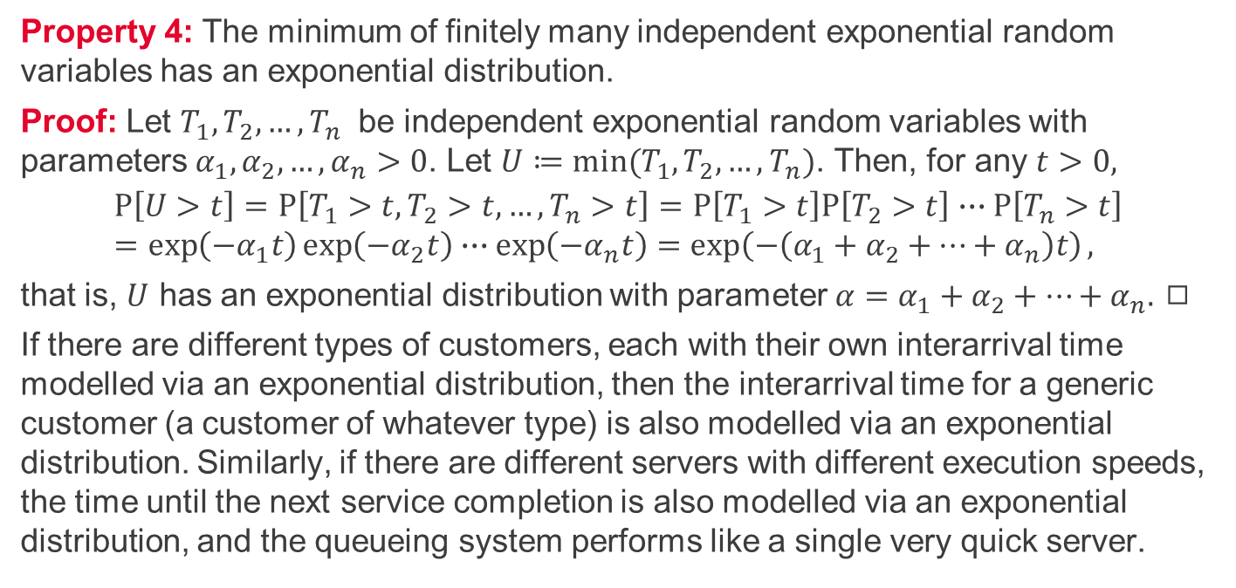
The exponential distribution – property 4
Property 4: The minimum of finitely many independent exponential random variables has an exponential distribution.
Proof: Let $T_{1}, T_{2},…, T_{n}$ be independent exponential random variables with parameters $α_{1},α_{2},…,α_{n}>0$. Let $U≔min⁡(T_{1}, T_{2},…, T_{n})$. Then, for any $t>0,$
$$P\left[U>t\right]=P\left[T_{1}>t, T_{2}>t, …,T_{n}>t\right]=P\left[T_{1}>t\right]P\left[T_{2}>t\right]∙∙∙P\left[T_{n}>t\right] \\ =\exp\left(−α_{1}t\right)\exp\left(−α_{2}t\right)∙∙∙\exp\left(−α_{n}t\right)=\exp\left(−\left(α_{1}+α_{2}+…+α_{n}\right)t\right),$$
that is, $U$ has an exponential distribution with parameter ${α=α}_{1}+α_{2}+…+α_{n}.$ ◻︎
If there are different types of customers, each with their own interarrival time modelled via an exponential distribution, then the interarrival time for a generic customer (a customer of whatever type) is also modelled via an exponential distribution. Similarly, if there are different servers with different execution speeds, the time until the next service completion is also modelled via an exponential distribution, and the queueing system performs like a single very quick server.

Slide 9
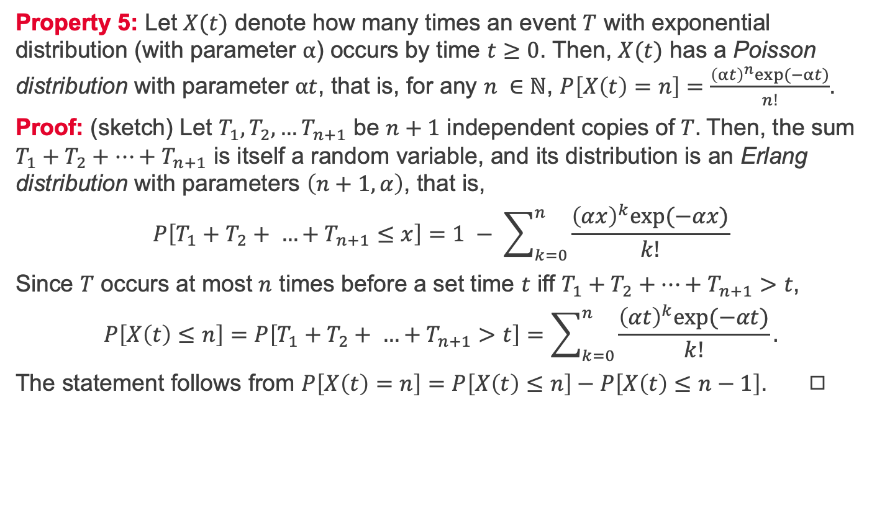
The exponential distribution – property 5
Property 5: Let $X(t)$ denote how many times an event $T$ with exponential distribution (with parameter $α$) occurs by time $t≥0$. Then, $X(t)$ has a Poisson distribution with parameter $αt$, that is, for any $n ∈ℕ$, $P\left[X\left(t\right)=n\right]=\frac{{\left(αt\right)}^{n}exp⁡(−αt)}{n!}$.
Proof: (sketch) Let $T_{1},T_{2},…T_{n+1}$ be $n+1$ independent copies of $T.$ Then, the sum $T_{1}+T_{2}+…+T_{n+1}$ is itself a random variable, and its distribution is an Erlang distribution with parameters $\left(n+1, α\right)$, that is,
$$P\left[T_{1}+T_{2}+ …+T_{n+1}≤x\right]=1 − \sum_{k=0}^{n}{\frac{{\left(αx\right)}^{k}exp⁡(−αx)}{k!}}$$
Since $T$ occurs at most $n$ times before a set time $t$ iff $T_{1}+T_{2}+…+T_{n+1}>t$,
$$P\left[X\left(t\right)≤n\right]=P\left[T_{1}+T_{2}+ …+T_{n+1}>t\right]=\sum_{k=0}^{n}{\frac{{\left(αt\right)}^{k}exp⁡(−αt)}{k!}}.$$
The statement follows from $P\left[X\left(t\right)=n\right]=$ $P\left[X\left(t\right)≤n\right]−P\left[X\left(t\right)≤n−1\right]$. ◻︎

Slide 10
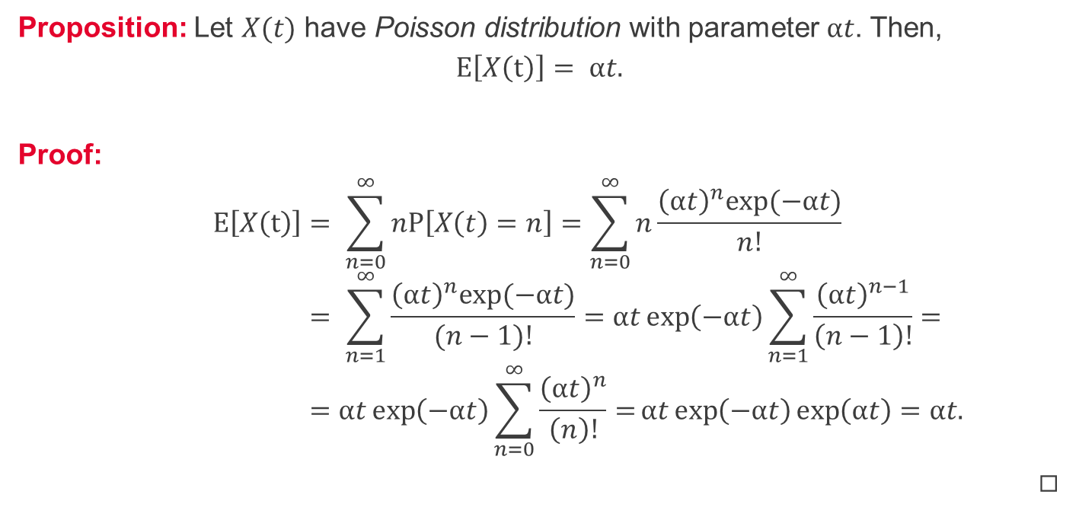
Expected value of a Poisson distribution
Proposition: Let $X(t)$ have Poisson distribution with parameter $αt$. Then,
$$E\left[X\left(t\right)\right]= αt.$$
Proof:
$$E\left[X\left(t\right)\right]= \sum_{n=0}^{∞}{nP\left[X\left(t\right)=n\right]}=\sum_{n=0}^{∞}{n\frac{{\left(αt\right)}^{n}exp⁡(−αt)}{n!}} \\ = \sum_{n=1}^{∞}{\frac{{\left(αt\right)}^{n}exp⁡(−αt)}{(n−1)!}}=αt\exp\left(−αt\right)\sum_{n=1}^{∞}{\frac{{\left(αt\right)}^{n−1}}{\left(n−1\right)!}=} \\ =αt\exp\left(−αt\right)\sum_{n=0}^{∞}{\frac{{\left(αt\right)}^{n}}{\left(n\right)!}=}αt\exp\left(−αt\right)\exp\left(αt\right)=αt.$$
◻︎

Slide 11
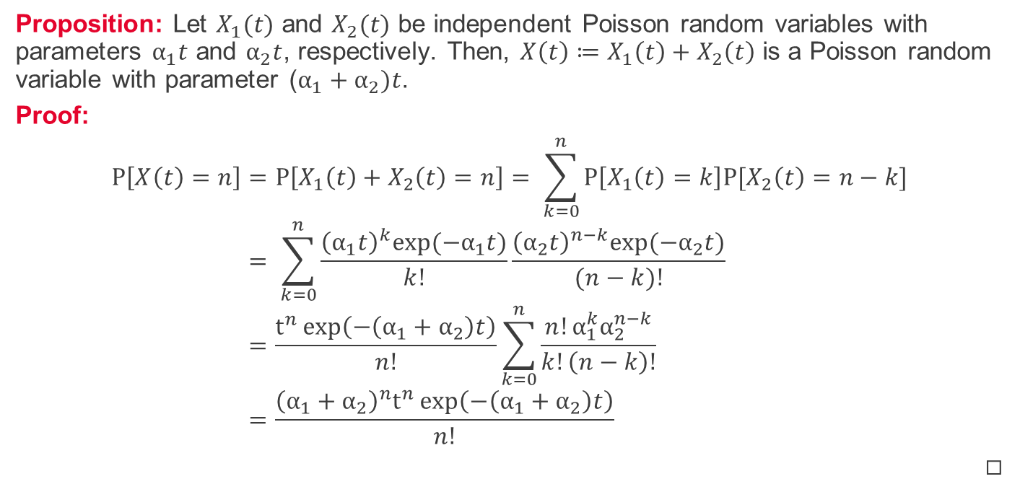
Sum of independent Poisson processes
Proposition: Let $X_{1}(t)$ and $X_{2}(t)$ be independent Poisson random variables with parameters $α_{1}t$ and $α_{2}t$, respectively. Then, ${X\left(t\right)≔X}_{1}\left(t\right)+X_{2}\left(t\right)$ is a Poisson random variable with parameter ($α_{1}+α_{2})t$.
Proof:
$$P\left[X\left(t\right)=n\right]=P\left[X_{1}\left(t\right)+X_{2}\left(t\right)=n\right]= \sum_{k=0}^{n}{P\left[X_{1}\left(t\right)=k\right]P[X_{2}\left(t\right)=n−k]} \\ = \sum_{k=0}^{n}{\frac{{\left(α_{1}t\right)}^{k}exp⁡(−α_{1}t)}{k!}\frac{{\left(α_{2}t\right)}^{n−k}exp⁡(−α_{2}t)}{(n−k)!}} \\ =\frac{t^{n}\exp\left(−\left(α_{1}+α_{2}\right)t\right)}{n!}\sum_{k=0}^{n}{\frac{n!α_{1}^{k}α_{2}^{n−k}}{k!\left(n−k\right)!}} \\ =\frac{{{\left(α_{1}+α_{2}\right)}^{n}t}^{n}\exp\left(−\left(α_{1}+α_{2}\right)t\right)}{n!}$$
◻︎

Slide 12
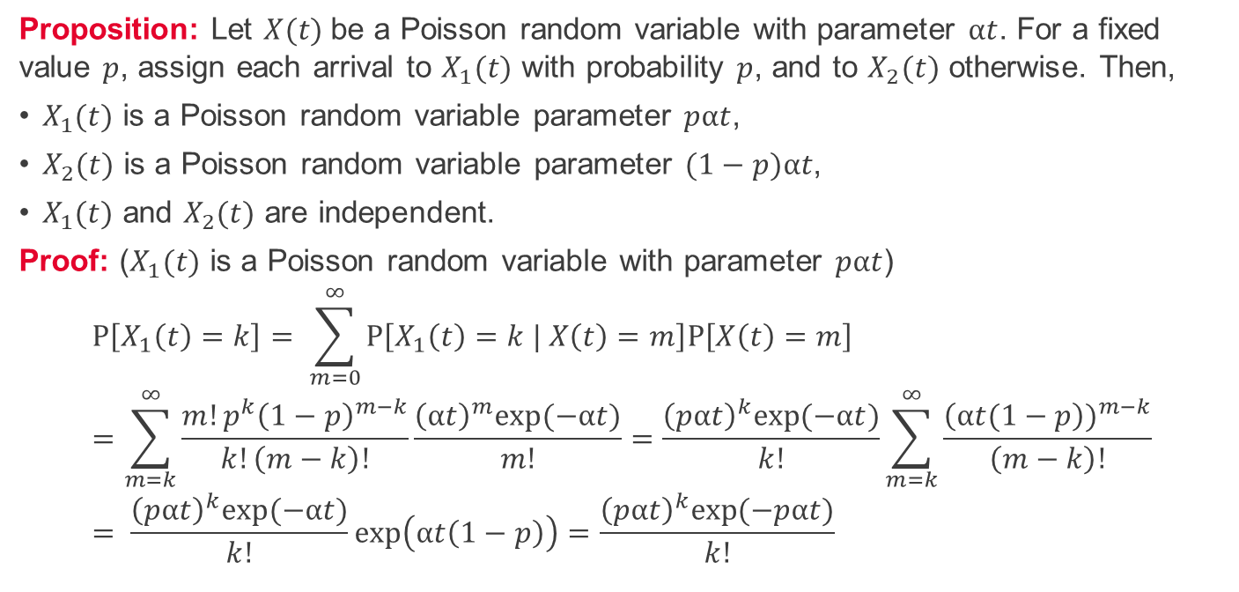
Splitting of a Poisson process 1/2
Proposition: Let $X(t)$be a Poisson random variable with parameter $αt$. For a fixed value $p$, assign each arrival to $X_{1}(t)$ with probability $p$, and to $X_{2}(t)$ otherwise. Then,
$X_{1}(t)$ is a Poisson random variable parameter $pαt$,
$X_{2}(t)$ is a Poisson random variable parameter $(1−p)αt$,
$X_{1}(t)$ and $X_{2}(t)$ are independent.
Proof: ($X_{1}(t)$ is a Poisson random variable with parameter $pαt$)
$$P\left[X_{1}\left(t\right)=k\right]= \sum_{m=0}^{∞}{P\left[X_{1}\left(t\right)=k | X\left(t\right)=m\right]P\left[X\left(t\right)=m\right]} \\ =\sum_{m=k}^{∞}{\frac{m!p^{k}{\left(1−p\right)}^{m−k}}{k!\left(m−k\right)!}}\frac{{\left(αt\right)}^{m}exp⁡(−αt)}{m!}=\frac{{\left(pαt\right)}^{k}exp⁡(−αt)}{k!}\sum_{m=k}^{∞}{\frac{{\left(αt(1−p\right))}^{m−k}}{\left(m−k\right)!}} \\ = \frac{{\left(pαt\right)}^{k}exp⁡(−αt)}{k!}\exp\left(αt\left(1−p\right)\right)=\frac{{\left(pαt\right)}^{k}exp⁡(−pαt)}{k!}$$

Slide 13
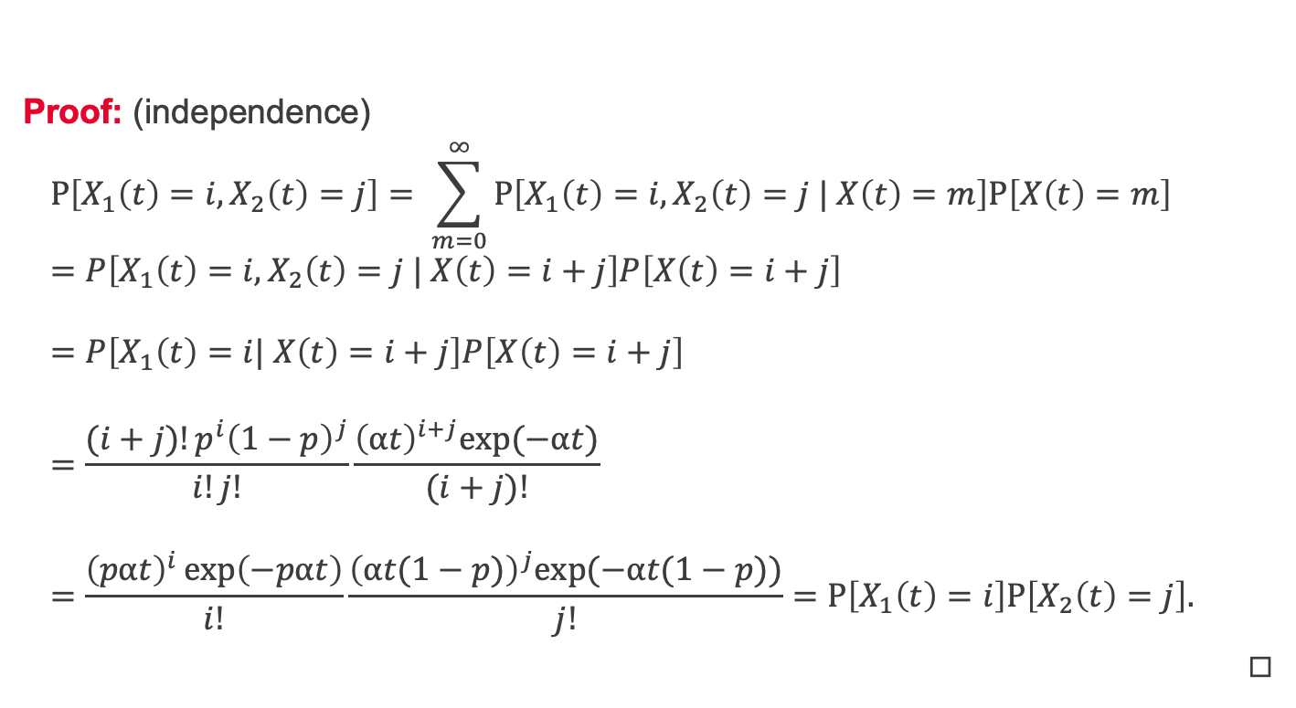
Splitting of a Poisson process 2/2
Proof: (independence)
$$P\left[X_{1}\left(t\right)=i,X_{2}\left(t\right)=j\right]= \sum_{m=0}^{∞}{P\left[X_{1}\left(t\right)=i, X_{2}\left(t\right)=j | X\left(t\right)=m\right]P\left[X\left(t\right)=m\right]} \\ =P\left[X_{1}\left(t\right)=i, X_{2}\left(t\right)=j | X\left(t\right)=i+j\right]P\left[X\left(t\right)=i+j\right] \\ =P\left[X_{1}\left(t\right)=i| X\left(t\right)=i+j\right]P\left[X\left(t\right)=i+j\right] \\ =\frac{(i+j)!p^{i}{\left(1−p\right)}^{j}}{i!j!}\frac{{\left(αt\right)}^{i+j}exp⁡(−αt)}{(i+j)!} \\ =\frac{{\left(pαt\right)}^{i}\exp\left(−pαt\right)}{i!}\frac{{\left(αt(1−p)\right)}^{j}exp⁡(−αt(1−p))}{j!}=P\left[X_{1}\left(t\right)=i\right]P\left[X_{2}\left(t\right)=j\right].$$
◻︎

Slide 14
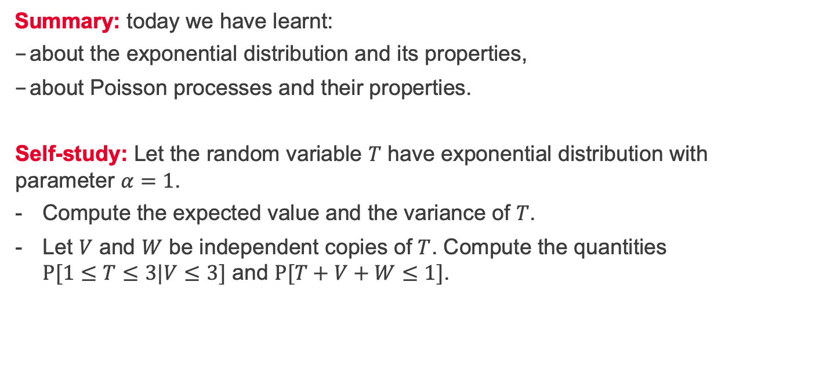
Summary and self-study
Summary: today we have learnt:
about the exponential distribution and its properties,
about Poisson processes and their properties.
Self-study: Let the random variable $T$ have exponential distribution with parameter $α=1$.
Compute the expected value and the variance of $T$.
Let $V$ and $W$ be independent copies of $T$. Compute the quantities $P[1≤T≤3|V≤3]$ and $P[T+V+W≤1]$.

